Slide 1
19CSE211-Computer Architecture & Organization MIPS Addressing Modes

Slide 2
MIPS Addressing Modes
Addressing modes are the ways of specifying an operand or a memory address.
Register Addressing
Immediate addressing
Base/Displacement addressing
PC-relative addressing
Pseudo direct addressing

Slide 3
Register Addressing
The simplest addressing mode is the register addressing.
Instructions using registers execute fast because they do not have the delay associated with memory access.
The number of registers is limited since only 5-bits are reserved to select a register.
Register addressing is a form of direct addressing.
The value in the register is an operand instead of being a memory address to an operand.

Slide 4
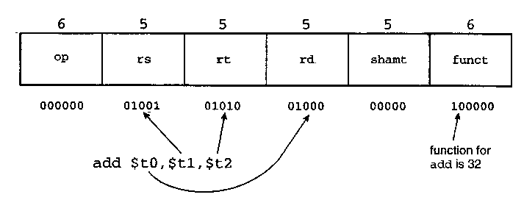
Register Addressing mode - Example

Slide 5
Immediate Addressing mode
MIPS immediate addressing means that one operand is a constant within the instruction itself.
The advantage of using it is that there is no need to have extra memory access to fetch the operand.
But keep in mind that the operand is limited to 16 bits in size.

Slide 6
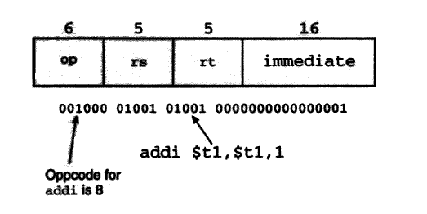
Immediate addressing mode- Examples

Slide 7
Base/Displacement addressing
The address of the operand is the sum of the offset value and the base value(rs). However, the size of operand is limited to 16 bits because each MIPS instruction fits into a word.
The offset value is a signed number which is represented in a two's complement format. Therefore , offset value can also be a negative value.

Slide 8
Base Addressing Example
Instruction : lw $t1 , 4 ($t2)
where $t1 = rs
$t2 = base (memory address)
4 = offset value
$t1 = Memory [$t2 +4]

